Slide 1

CAD recipes
Rutherford Appleton laboratory
Wire-bonding @ interconnect

Slide 2
Mechanical CAD PCB CAD (microns) Wafer CAD (nannymetres)
Disconnects
Notes:
History of CAD
Mechanical to pcb
Pcbs in mechanical drawings cant show features, only outlines.
PCB CAD software
Wafer software is a different world

Slide 3
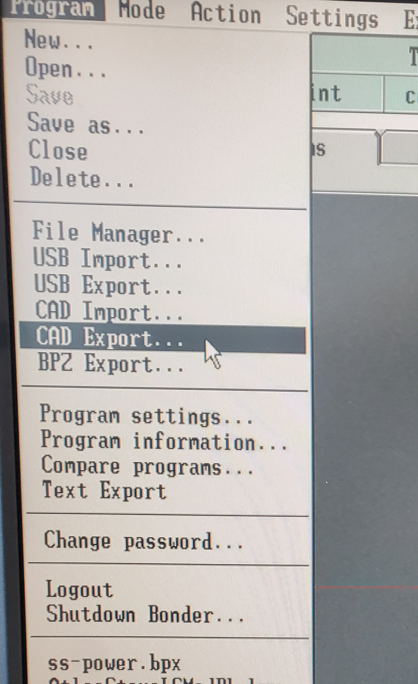
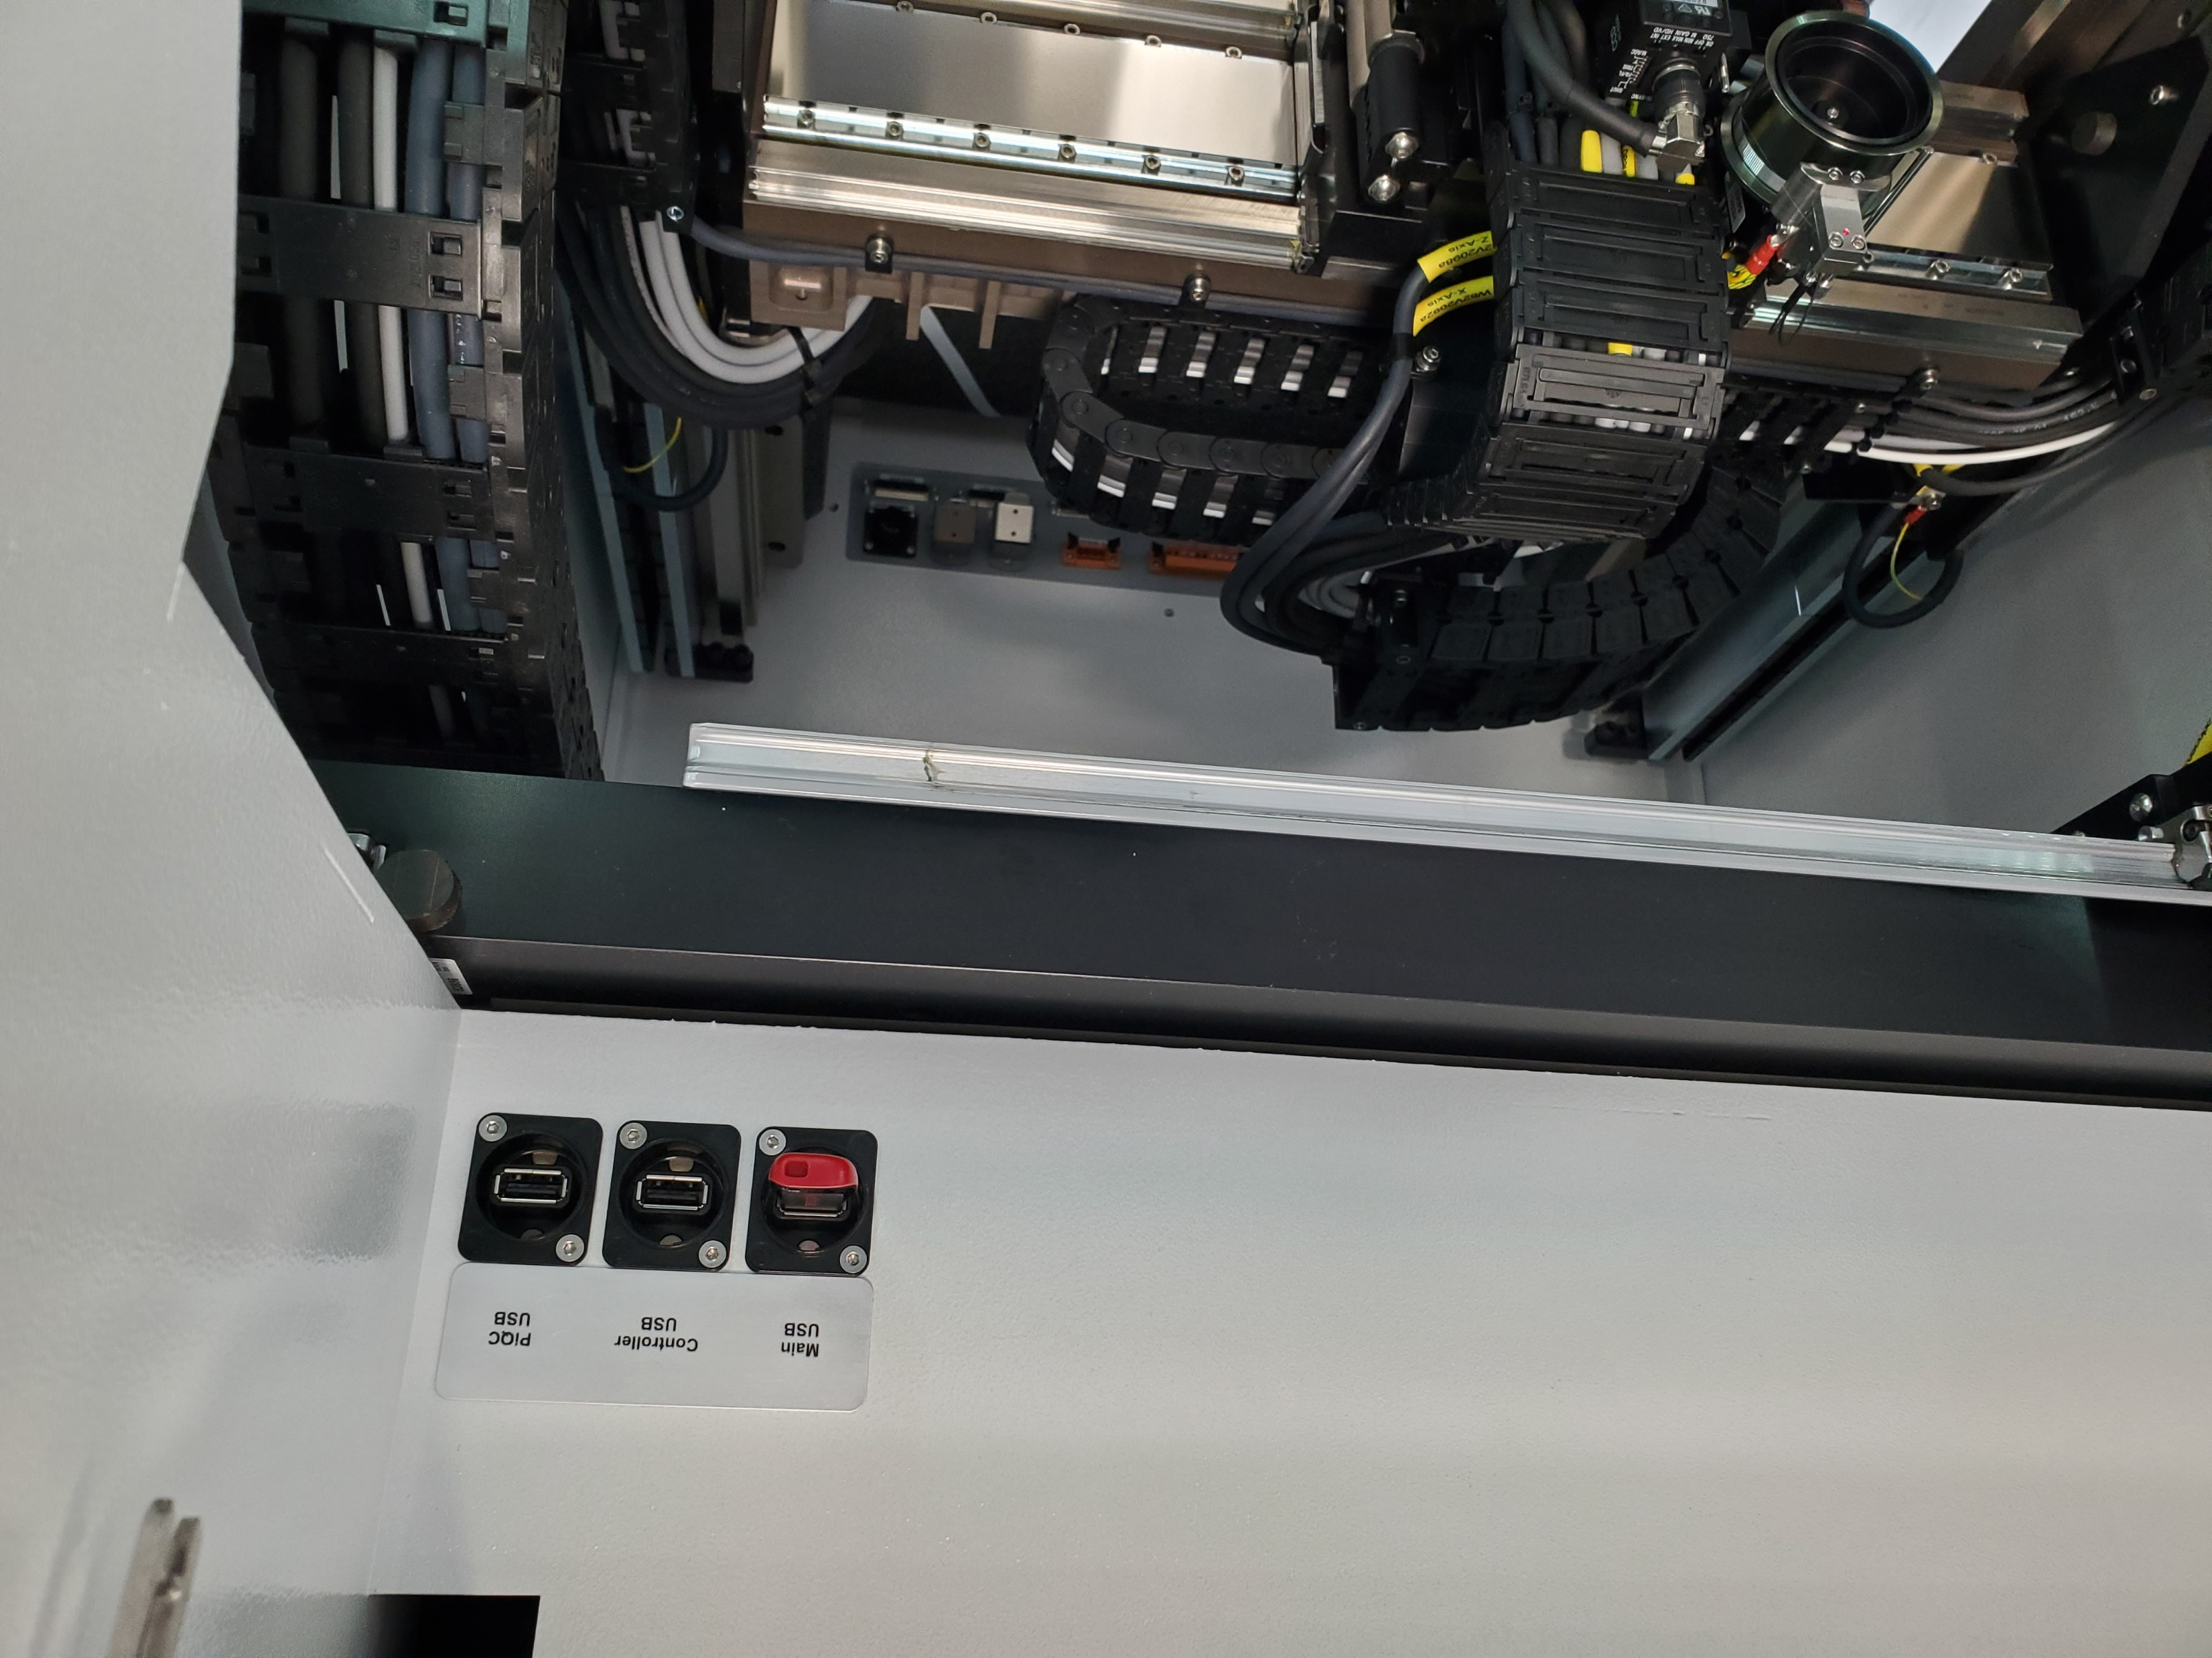
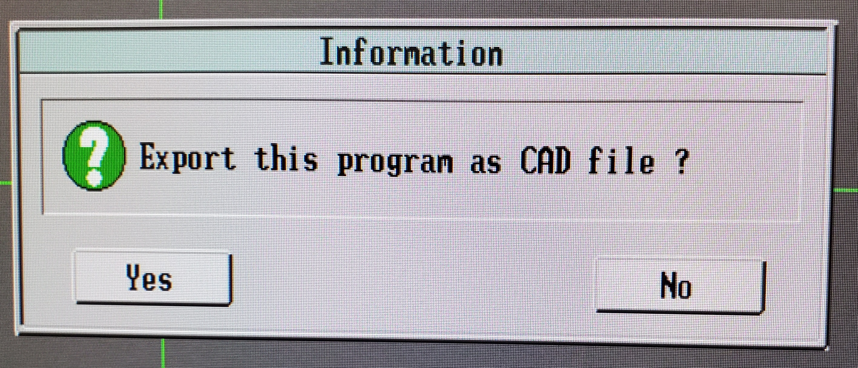
Export program as CAD
.CAD file suffix but .csv file-type
Notes:
What does a CAD file look
USB stick formatted to 2 Gb.
Must be plugged in when machine is booted.
.CAD file suffix but csv file-type

Slide 4
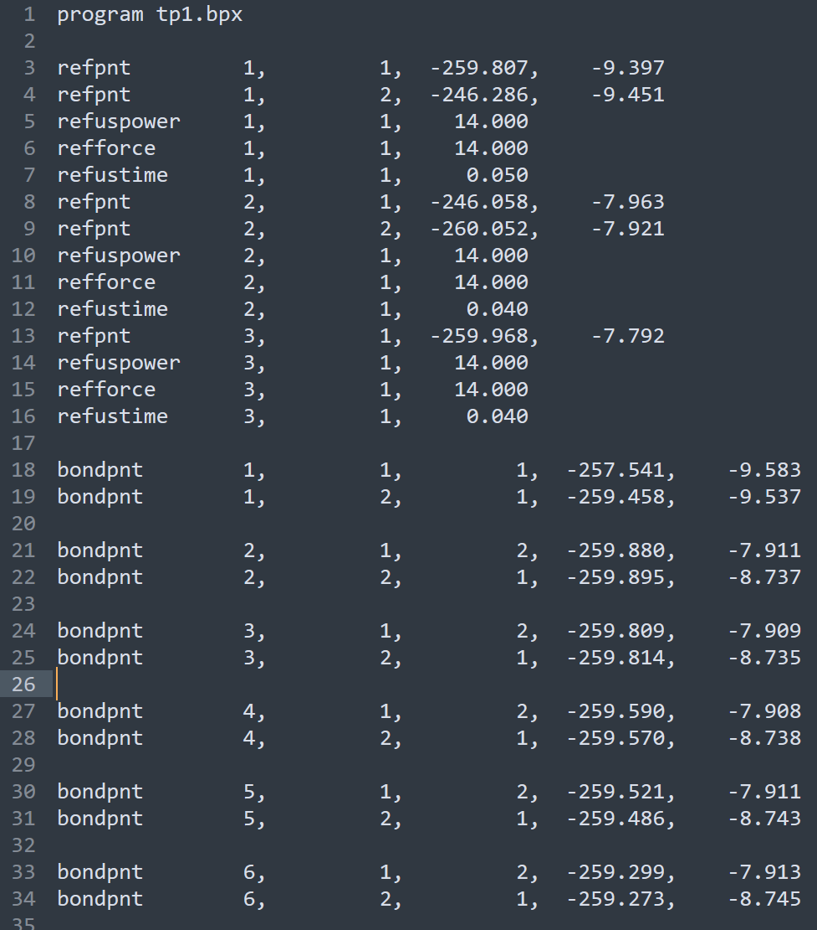
Title
1st reference system
2nd reference system
3rd reference system
Bond 1 source
Bond 2 destination
bondpnt | #Wire | #Bond | #Ref.sys. | x | y
Notes:
Note that it is comma delimited.
Note that it is well formatted so can be read in a text editor
Note that the bondpnt #num is one column, no comma separator.
Note that there are few bonding parameters.
To merge two CAD files

Slide 5
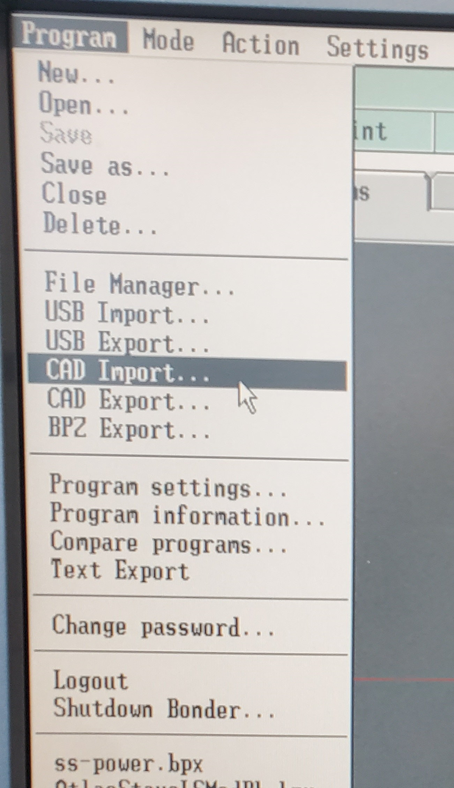
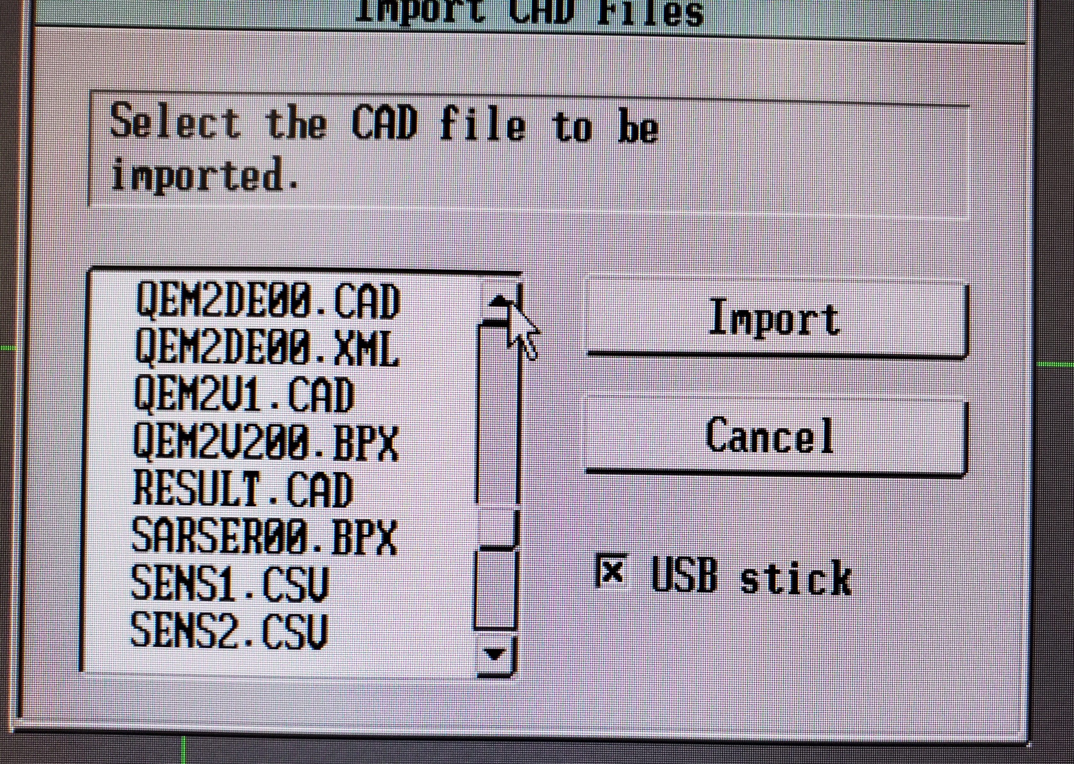
Import program as CAD
Note the 8.3 style file names. Ensure the first 6 characters are meaningful to you!
Notes:
Notice the 8.3 style file name.
Ensure the first 6 characters are meaningful to you

Slide 6

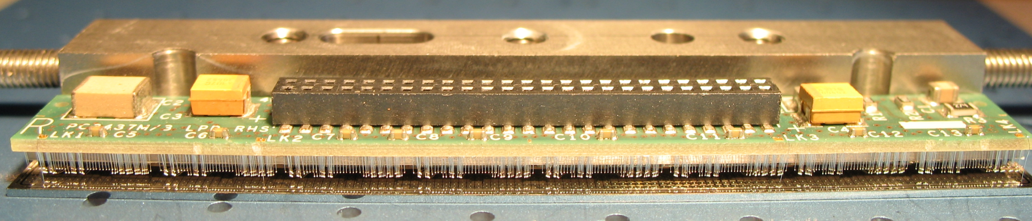
One die program proved inadequate over time
Each end die acquired its own program
Eventually combined all 3 programs to bond a complete module
Reference each die
Save as new prog
Export each CAD file.
___LPD1___
____________________________________LPD2-7_________________________________
___LPD8___
LPD Module
Notes:
Must Hve a workpiece to hand.
Reference each chip and save in separate files.
Export the CAD files.
In an Excel file, import each CAD file in a separate sheet.
On a new sheet start to build the master references
On another sheet, compile the wire list from each sheet.

Slide 7
Generating a CAD file
Wafer CAD data (bond pad centres)
PCB CAD data
Pin no. | x | y
1 | 63.0515 | 188.829
2 | 63.0515 | 188.709
… | … | …
344 | 63.48 | 189.2235
Pin (rpt) | x | y
1 | 60.3515 | 188.829
2 | 57.0515 | 188.709
… | … | …
344 | 63.48 | 192.1235
Notes:
CSV/Spreadsheet for chip design , listing pad centres for pin 1...
From the pcb design, corresponding pad centres for the pin nos.
The origins may not coincide!!!

Slide 8
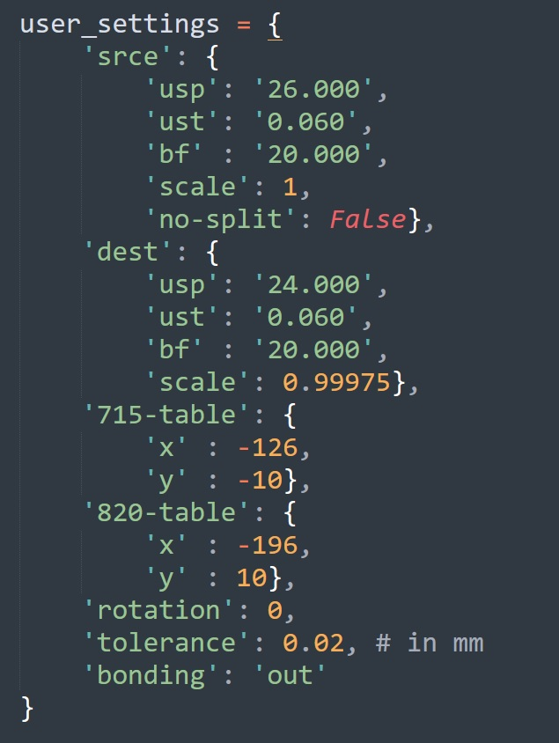
cad.py
US power
US time
Bond force
No Split
True if one die row bonds to one pcb row
False if one die row bonds to more than one pcb row.
Rotation
If the layout is wanted in a different orientation.
Scale
If the pcb shrinkage is significant
Translation
To centre the job on the bonder table coordinates
Bonding ‘Out’
Assumes chip to substrate, chip as source.
i.e. not packages bonded inwards
Notes:
Cad.py solves the tedious part of irregular chip designs

Slide 9
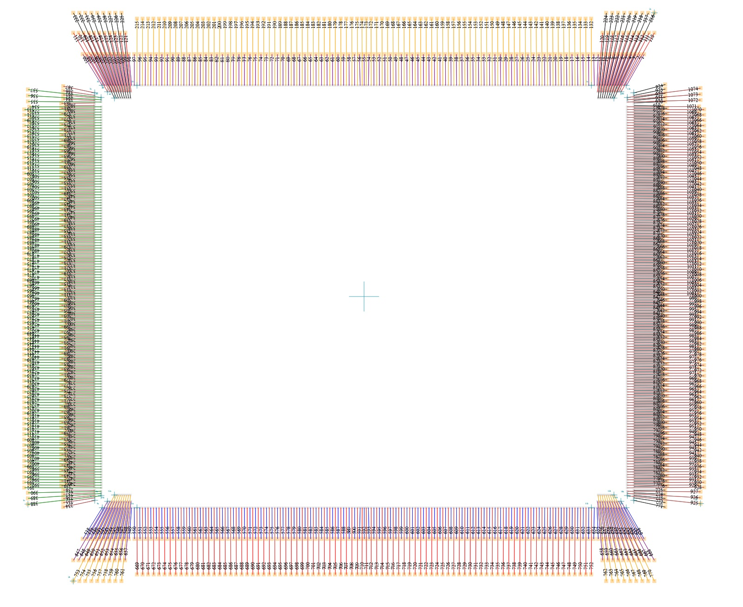
CAD Examples
Just a few pics from my home gallery…
Notes:
Notice the 8.3 style file name.
Ensure the first 6 characters are meaningful to you

Slide 10
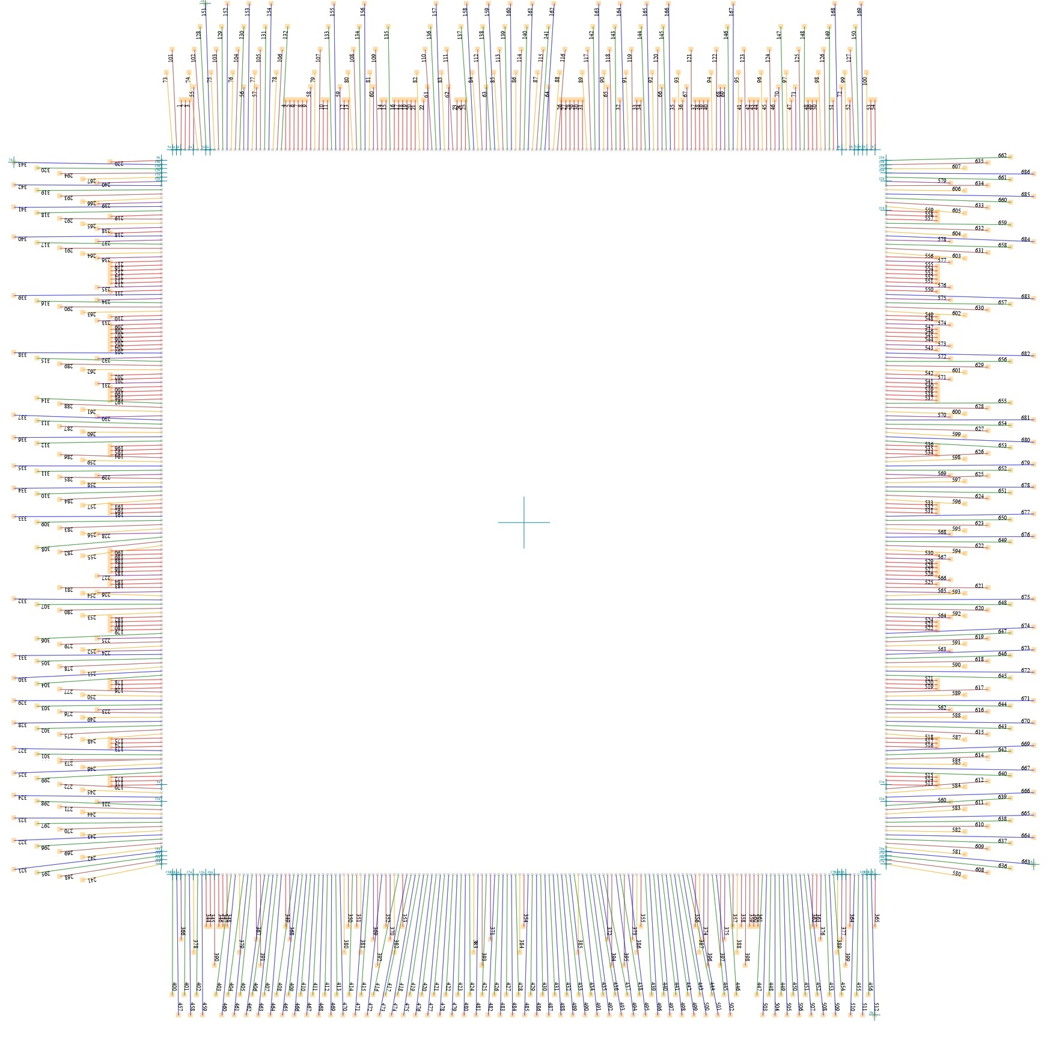
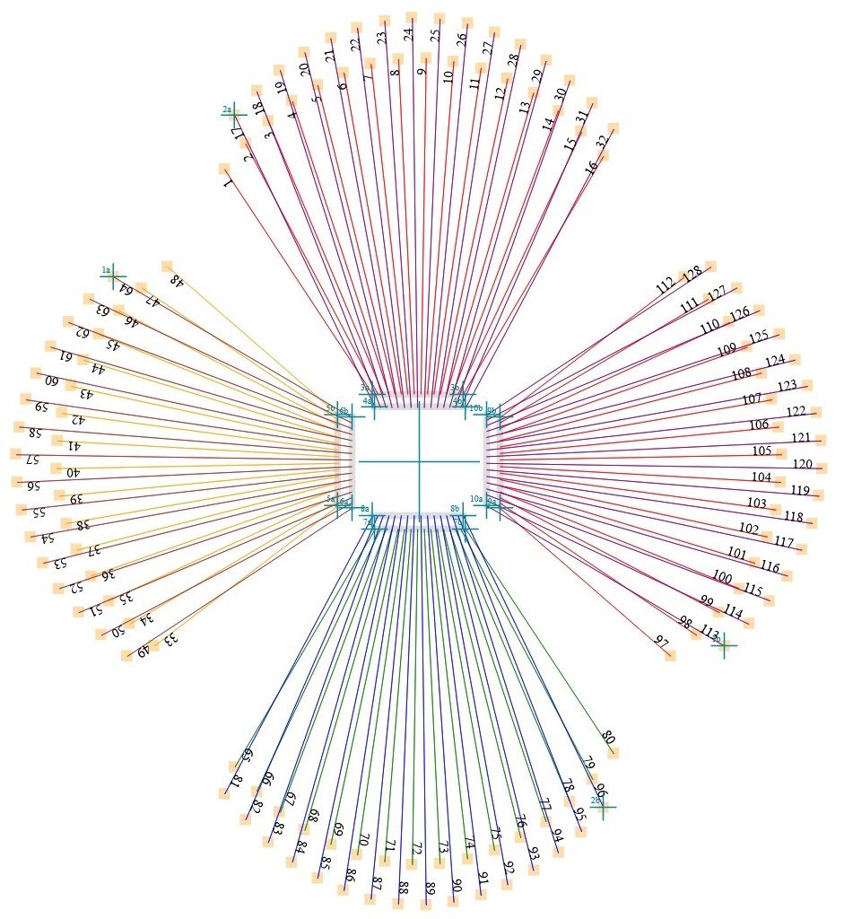
CAD Examples
Just a few pics from my home gallery…
Notes:
Notice the 8.3 style file name.
Ensure the first 6 characters are meaningful to you

Slide 11
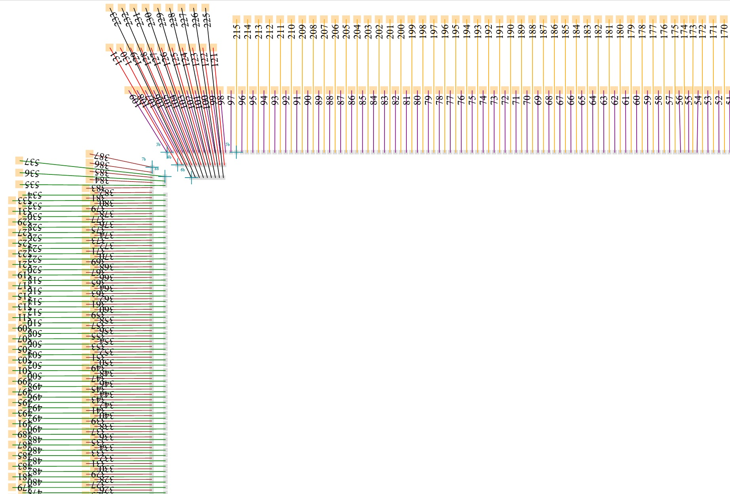
svg.py
For debugging CAD output
Bonding order
Up, left, down, right.
Notes:
Svg.py produces a map which can display wire numbers in the program, reference points.
Currently limited to my kind of bond programs.
It should also add chip pin numbers. But font sizes are a problem on larger chips.

Slide 12
Accessible on Github https://github.com/paulbuu/cad4wires
Rutherford Appleton laboratory
Wire-bonding @ interconnect

